Slide 1
Titanic Survivor Prediction Model
Akshat shah iit jodhpur

Slide 2
Problem Statement
The objective is to create a classifier model which can find out whether a passenger aboard the titanic survived or not based on a certain set of features

Slide 3
Data Set Details
The training data set contains 891 samples each of 12 attributes. The data set consisted of 549 instances of ‘non-survivor’ class and 342 instances of ‘survivor’ class
The testing data set contains 418 samples having similar attributes
The attributes are: Passenger ID, Passenger Class, Name, Sex, Age, SibSp (# of siblings and/or spouse), ParCh (# of parents and/or children), Ticket no., Fare, Cabin no, Embarked (Place of boarding) and Survived (Survival status)

Slide 4
Specific Characteristics of Data Set
People did not necessarily pay the same amount of money for a ticket; some people paid more for a third class than a first class

Slide 5
Data Preprocessing (Embarked)
Only 2 values for Embarked are missing out of 891
C = Cherbourg; Q = Queenstown; S = Southampton
Missing values were replaced with S (Majority)

Slide 6
Data Preprocessing (Fare)
15 values are missing out of 891
Missing values were replaced with Median of respective class

Slide 7
Data Preprocessing (Age)
177 values are missing out of 891
Missing values of Age were replaced using Decision Tree Regressor model with attributes Pclass, Title, Sex, SibSp, ParCh, Fare

Slide 8
Feature Engineering (Deck and Pos.)
Only 204 values out of 891 values of Cabin No. are present
Deck id would be 1st letter in Cabin No.
Position in the ship is found using numbers following the Deck id in the Cabin No.
Using k-means clustering, Position is divided into 3 classes, namely: ‘front’, ‘middle’ and ‘end'

Slide 9
Feature Engineering (Family Size)
Family Size is obtained by adding ParCh, SibSp and the person himself/herself

Slide 10
Feature Engineering (Mother/Child)
For every female (from attribute Sex), if ParCh > 0, Title != ‘Miss’ then that lady is a Mother
For every person, if Age < 18, ParCh > 0, then that person is a Child

Slide 11
Feature Engineering (Family Id)
Family Id is defined using Family Size and Surname as two different attributes
For Family Size <= 2, Family Id is ‘Small’

Slide 12
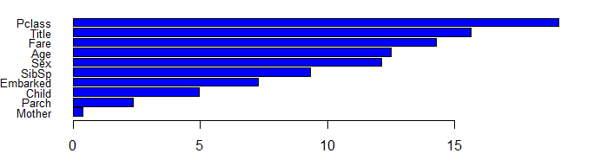
Details of Prediction Model
Importance Plot using Random Forest on attributes of limited levels namely: Pclass, Title, Fare, Age, Sex, SibSp, Embarked, Child, ParCh, Mother

Slide 13
Details of Prediction Model
Prediction of Survival Status was done using Cforest (Coditional Inference Forest) Model with attributes FamilyId2, CabinPos, Deck, Pclass, Sex, Age, SibSp, Parch, Fare, Embarked, Title, Mother, Child, Deck

Slide 14
Results
The accuracy obtained was 81.34% when tested on the given data of sample size of 418 people

Slide 15
References
https://www.kaggle.com/c/titanic/forums

Slide 16
THANK YOU

